Slide 1
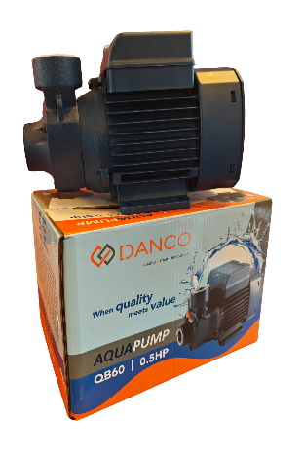
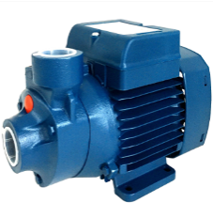
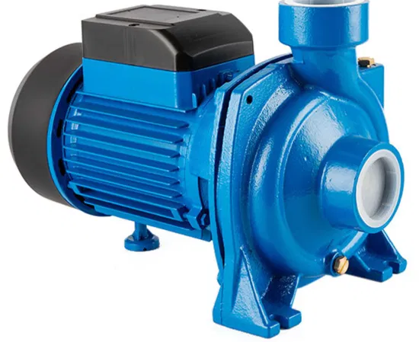
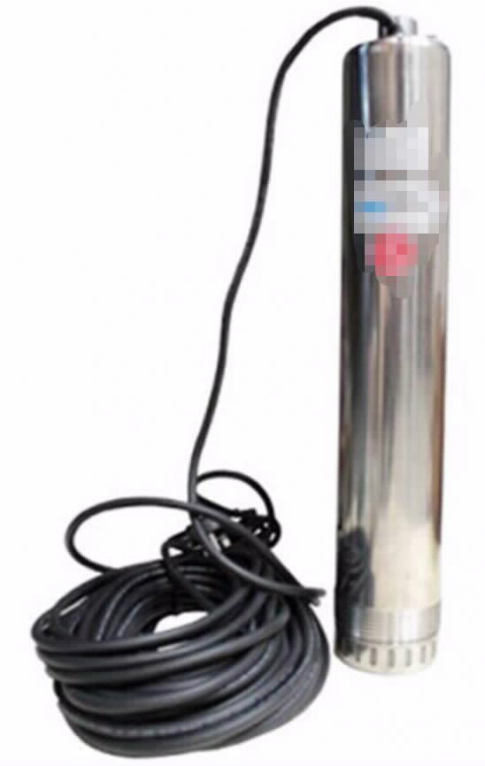
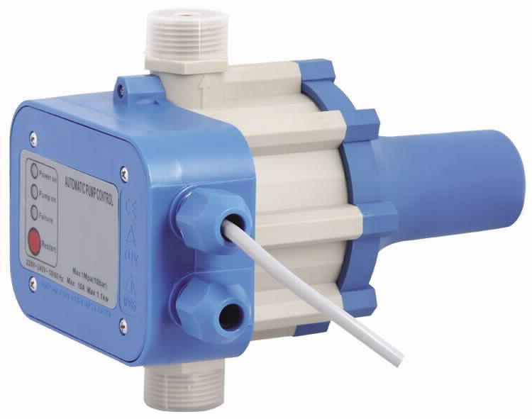
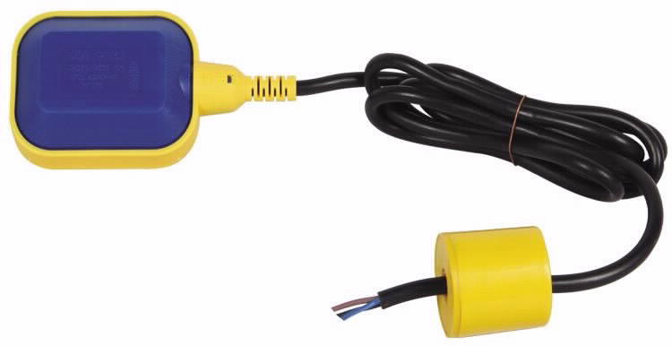
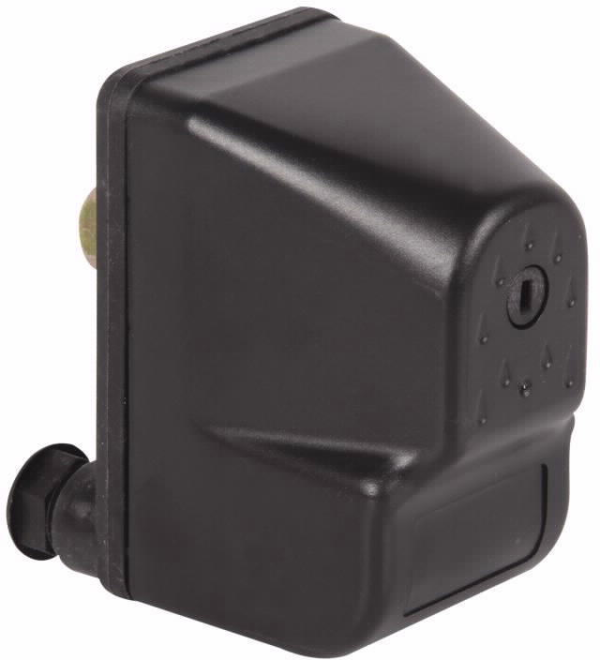
PRICE CATALOGUE
Aqua pump QB60 0.5HP
Aqua Surface Pump CPM158
Kes. 9,280
Kes. 27,750
Electric Pressure Controller PC-4A
Kes. 9,600
1.2 HP Submersible Water Pump SCM5
Kes. 76,800
Floating Switch 6M PVC
Pressure Switch SK-6
Kes. 3,430
Kes. 2,560
Submersible Water Pump
1.2 HP – 83,840 Kes.
1 HP – 50,230 Kes.
Danco Capital Limited | PO Box 46206-00100 | Nairobi, Kenya
Tel +254 731641414 | +254 711641414
E mail: info@dancocapital.co.ke
Website: www.dancocapital.co.ke
*Prices are Subject to VAT

